Slide 1

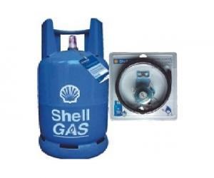
Gas selling support system
GSS team

Slide 2
About Us
Team Member:
Nguyễn Xuân Quyết
Nguyễn Đức Vượng
Đinh Nho Hào
Lê Thế Đại Dương
Nguyễn Huy Tuấn
Supervisor:
Phan Duy Hùng

Slide 3
Objectives
Introduction and idea
Target
Function and requirement
Improvement
Technology solution
Introduction and idea
Target
Function and requirement
Improvement
Technology solution
Introduction and idea
Target
Function and requirement
Improvement
Technology solution
1
1
1
2
3
4
5

Slide 4
Introduction and idea
Reality of Gas shop in Vietnam
Order by telephone
Storing data problem
Low service when communicate with customer by telephone
Opportunities
Develop a system support communicate with customer by telephone

Slide 5
Target
Fulfill the requirements of a capstone project
Improve service of gas shop
Make a system that can be traded
Have more knowledge about new technical after project

Slide 6
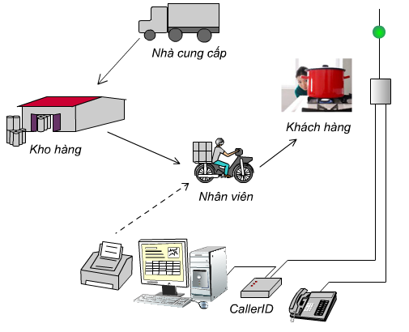
Function and requirement

Slide 7
Function and requirement
Embedded
Connect with telephone.
Decode and log telephone number of customer (DTMF and FSK type).
Transmit phone number to computer.

Slide 8
Function and requirement
Software
Support User on communicating with customers by telephone
Display information of customer by phone number.
Log miscall
Statistic and calculate purchasing circle
Print bill with map
Finding shortest way

Slide 9
Function and requirement
Support Management
Manage information of customer
Manage information of products
Manage import-export store
Manage profit, turnover and products by month or quarter
Manage business activities: debt, report, discount, promotion…

Slide 10
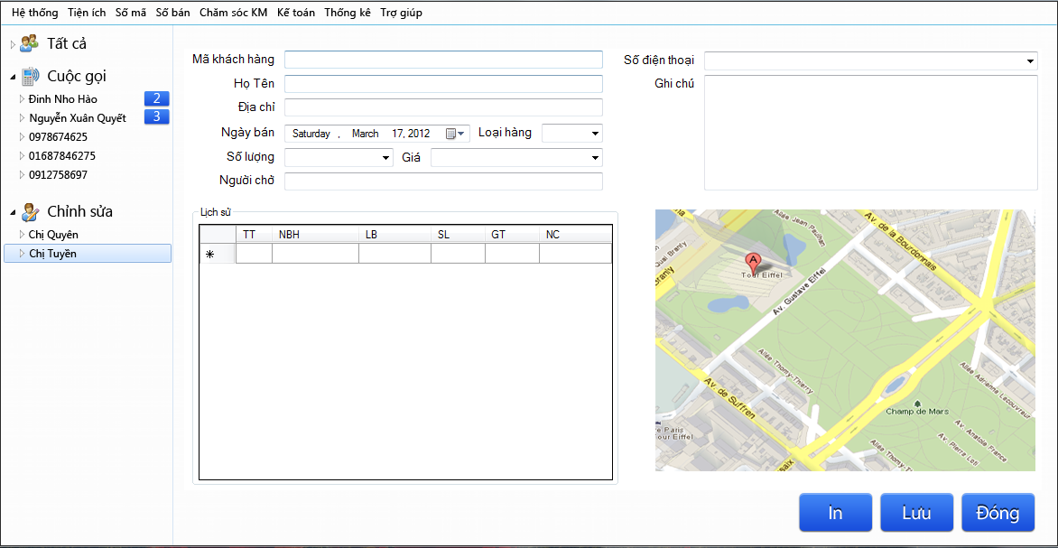
Function and requirement

Slide 11
Improvement
Compare with existing system:
Find shortest path to support delivery
Contain more function to improve customer support services.
Low price

Slide 12
Technology solution
Low price
Stable
Easy to develop and maintain
Meet requirement
Base on:

Slide 13
Technology solution
PIC16F876a
SM8223a
RS232
C# and SQL server

Slide 14
THANK YOU!

